Slide 1
Outline
Introduction
Background
Distributed Database Design
Database Integration
Semantic Data Control
Distributed Query Processing
  Overview
  Query decomposition and localization
  Distributed query optimization
Multidatabase Query Processing
Distributed Transaction Management
Data Replication
Parallel Database Systems
Distributed Object DBMS
Peer-to-Peer Data Management
Web Data Management
Current Issues

Slide 2
Step 3 – Global Query Optimization
Input: Fragment query
Find the best (not necessarily optimal) global schedule
  Minimize a cost function
  Distributed join processing
    Bushy vs. linear trees
    Which relation to ship where?
    Ship-whole vs ship-as-needed
  Decide on the use of semijoins
    Semijoin saves on communication at the expense of more local processing.
  Join methods
    nested loop vs ordered joins (merge join or hash join)

Slide 3
Cost-Based Optimization
Solution space
  The set of equivalent algebra expressions (query trees).
Cost function (in terms of time)
  I/O cost + CPU cost + communication cost
  These might have different weights in different distributed environments (LAN vs WAN).
  Can also maximize throughput
Search algorithm
  How do we move inside the solution space?
  Exhaustive search, heuristic algorithms (iterative improvement, simulated annealing, genetic,…)

Slide 4
Query Optimization Process
Input Query
Search Space
Generation
Transformation
Rules
Equivalent QEP
Search
Strategy
Cost Model
Best QEP

Slide 5
Search Space
▷◁ _{PNO}
Search space characterized by alternative execution
Focus on join trees
For N relations, there are O(N!) equivalent join trees that can be obtained by applying commutativity and associativity rules
  SELECT ENAME,RESP
  FROM EMP, ASG,PROJ
  WHERE EMP.ENO=ASG.ENO
  AND ASG.PNO=PROJ.PNO
▷◁ _{ENO}
PROJ
EMP
ASG
▷◁ _{ENO}
▷◁ _{PNO}
EMP
PROJ
ASG
▷◁ _{ENO,PNO}
×
ASG
PROJ
EMP

Slide 6
Search Space
Restrict by means of heuristics
  Perform unary operations before binary operations
  …
Restrict the shape of the join tree
  Consider only linear trees, ignore bushy ones
Linear Join Tree
Bushy Join Tree
⋈
⋈
⋈
R₄
⋈
R₃
⋈
⋈
R₁
R₂
R₁
R₂
R₃
R₄

Slide 7
Search Strategy
How to “move” in the search space.
Deterministic
  Start from base relations and build plans by adding one relation at each step
  Dynamic programming: breadth-first
  Greedy: depth-first
Randomized
  Search for optimalities around a particular starting point
  Trade optimization time for execution time
  Better when > 10 relations
  Simulated annealing
  Iterative improvement

Slide 8
Search Strategies
⋈
Deterministic
⋈
⋈
R₄
⋈
⋈
R₃
⋈
R₃
R₁
R₂
R₁
R₂
R₁
R₂
Randomized
⋈
⋈
⋈
R₃
⋈
R₂
R₁
R₂
R₁
R₃

Slide 9
Cost Functions
Total Time (or Total Cost)
  Reduce each cost (in terms of time) component individually
  Do as little of each cost component as possible
  Optimizes the utilization of the resources
  Increases system throughput
Response Time
  Do as many things as possible in parallel
  May increase total time because of increased total activity

Slide 10
Total Cost
Summation of all cost factors
  Total cost = CPU cost + I/O cost + communication cost
  CPU cost = unit instruction cost ∗ no.of instructions
  I/O cost = unit disk I/O cost ∗ no. of disk I/Os
  communication cost = message initiation + transmission

Slide 11
Total Cost Factors
Wide area network
  Message initiation and transmission costs high
  Local processing cost is low (fast mainframes or minicomputers)
  Ratio of communication to I/O costs = 20:1
Local area networks
  Communication and local processing costs are more or less equal
  Ratio = 1:1.6

Slide 12
Response Time
Elapsed time between the initiation and the completion of a query
  Response time = CPU time + I/O time + communication time
  CPU time = unit instruction time * no. of sequential instructions
  I/O time = unit I/O time * no. of sequential I/Os
  communication time = unit msg initiation time * no. of sequential msg
  + unit transmission time * no. of sequential bytes

Slide 13
Example
Site 1
x units
Site 3
Site 2
y units
Assume that only the communication cost is considered
Total time = 2 ⋅ message initialization time + unit transmission time * (x+y)
Response time = max {time to send x from 1 to 3, time to send y from 2 to 3}
time to send x from 1 to 3 = message initialization time
+ unit transmission time * x
time to send y from 2 to 3 = message initialization time
+ unit transmission time * y

Slide 14
Optimization Statistics
Primary cost factor: size of intermediate relations
  Need to estimate their sizes
Make them precise ⇒ more costly to maintain
Simplifying assumption: uniform distribution of attribute values in a relation

Slide 15
Statistics
For each relation R[A₁, A₂, …, A_{n}] fragmented as R₁, …, R_{r}
  length of each attribute: length(A_{i})
  the number of distinct values for each attribute in each fragment: card(Π_{Ai}R_{j})
  maximum and minimum values in the domain of each attribute: min(A_{i}), max(A_{i})
  the cardinalities of each domain: card(dom[A_{i}])
The cardinalities of each fragment: card(R_{j}) Selectivity factor of each operation for relations
  For joins
card(R ⋈S)
SF ⋈ (R,S) =
card(R) ∗ card(S)

Slide 16
Intermediate Relation Sizes
Selection
    size(R) = card(R) ⋅ length(R)
    card(σ_{F}(R)) = SF_{σ}(F) ⋅ card(R)
  where
1
S F_{σ}(A = value) =
card(∏_{A}(R))
max(A) – value
S F_{σ}(A >value) =
max(A) – min(A)
value – max(A)
S F_{σ}(A <value) =
max(A) – min(A)
SF_{σ}(p(A_{i})∧ p(A_{j})) = SF_{σ}(p(A_{i})) ⋅ SF_{σ}(p(A_{j}))
SF_{σ}(p(A_{i}) ∨ p(A_{j})) = SF_{σ}(p(A_{i})) + SF_{σ}(p(A_{j})) – (SF_{σ}(p(A_{i})) ⋅ SF_{σ}(p(A_{j})))
SF_{σ}(A∈{value}) = SF_{σ}(A= value) * card({values})

Slide 17
Intermediate Relation Sizes
Projection
  card(Π_{A}(R))=card(R)
Cartesian Product
  card(R ⋅ S) = card(R) * card(S)
Union
  upper bound: card(R ∪ S) = card(R) + card(S)
  lower bound: card(R ∪ S) = max{card(R), card(S)}
Set Difference
  upper bound: card(R–S) = card(R)
  lower bound: 0

Slide 18
Intermediate Relation Size
Join
  Special case: A is a key of R and B is a foreign key of S
  card(R ⋈_{A=B} S) = card(S)
  More general:
    card(R ⋈ S) = SF⋈ * card(R) ⋅ card(S)
Semijoin
  card(R ⋉_{A} S) = SF⋉(S.A) * card(R)
  where
  SF⋉(R ⋉_{A} S)= SF⋉(S.A) =
card(∏_{A}(S))
card(dom[A])

Slide 19
Histograms for Selectivity Estimation
For skewed data, the uniform distribution assumption of attribute values yields inaccurate estimations
Use an histogram for each skewed attribute A
  Histogram = set of buckets
    Each bucket describes a range of values of A, with its average frequency f (number of tuples with A in that range) and number of distinct values d
    Buckets can be adjusted to different ranges
Examples
  Equality predicate
    With (value in Range_{i}), we have: SF_{σ}(A = value) = 1/d_{i}
  Range predicate
    Requires identifying relevant buckets and summing up their frequencies

Slide 20
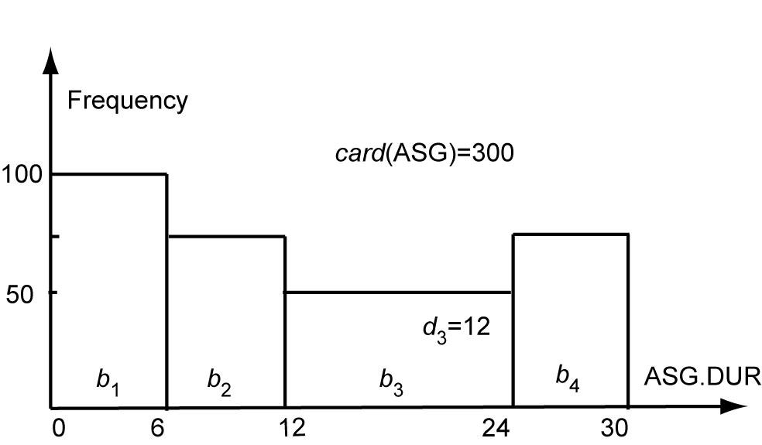
Histogram Example
For ASG.DUR=18: we have SF=1/12 so the card of selection is 300/12 = 25 tuples
For ASG.DUR≤18: we have min(range₃)=12 and max(range₃)=24 so the card. of selection is 100+75+(((18−12)/(24 − 12))*50) = 200 tuples

Slide 21
Centralized Query Optimization
Dynamic (Ingres project at UCB)
  Interpretive
Static (System R project at IBM)
  Exhaustive search
Hybrid (Volcano project at OGI)
  Choose node within plan

Slide 22
Dynamic Algorithm
Decompose each multi-variable query into a sequence of mono-variable queries with a common variable
Process each by a one variable query processor
  Choose an initial execution plan (heuristics)
  Order the rest by considering intermediate relation sizes
  No statistical information is maintained

Slide 23
Dynamic Algorithm–Decomposition
Replace an n variable query q by a series of queries
q₁→q₂ → … → q_{n}
where q_{i} uses the result of q_{i-1}.
Detachment
  Query q decomposed into q' → q" where q' and q" have a common variable which is the result of q'
Tuple substitution
  Replace the value of each tuple with actual values and simplify the query
    q(V₁, V₂, ... V_{n}) → (q' (t₁, V₂, V₂, ... , V_{n}), t₁∈R)

Slide 24
Detachment
q: SELECT V₂.A₂,V₃.A₃, …,V_{n}.A_{n}
FROM R₁ V₁, …,R_{n} V_{n}
WHERE P₁(V₁.A₁’)AND P₂(V₁.A₁,V₂.A₂,…, V_{n}.A_{n})
⇓
q': SELECT V₁.A₁ INTO R₁'
FROM R₁ V₁
WHERE P₁(V₁.A₁)
q": SELECT V₂.A₂, …,V_{n}.A_{n}
FROM R₁' V₁, R₂ V₂, …,R_{n} V_{n}
WHERE P₂(V₁.A₁, V₂.A₂, …,V_{n}.A_{n})

Slide 25
Detachment Example
Names of employees working on CAD/CAM project
  q₁: SELECT EMP.ENAME
  FROM EMP, ASG, PROJ
  WHERE EMP.ENO=ASG.ENO
  AND ASG.PNO=PROJ.PNO
  AND PROJ.PNAME="CAD/CAM"
  ⇓
  q₁₁: SELECT PROJ.PNO INTO JVAR
  FROM PROJ
  WHERE PROJ.PNAME="CAD/CAM"
  q': SELECT EMP.ENAME
  FROM EMP,ASG,JVAR
  WHERE EMP.ENO=ASG.ENO
  AND ASG.PNO=JVAR.PNO

Slide 26
Detachment Example (cont’d)
  q': SELECT EMP.ENAME
  FROM EMP,ASG,JVAR
  WHERE EMP.ENO=ASG.ENO
  AND ASG.PNO=JVAR.PNO
  ⇓
  q₁₂: SELECT ASG.ENO INTO GVAR
  FROM ASG,JVAR
  WHERE ASG.PNO=JVAR.PNO
  q₁₃: SELECT EMP.ENAME
  FROM EMP,GVAR
  WHERE EMP.ENO=GVAR.ENO

Slide 27
Tuple Substitution
q₁₁ is a mono-variable query
q₁₂ and q₁₃ is subject to tuple substitution
Assume GVAR has two tuples only: 〈E1〉 and 〈E2〉
Then q₁₃ becomes
  q₁₃₁: SELECT EMP.ENAME
  FROM EMP
  WHERE EMP.ENO="E1"
  q₁₃₂: SELECT EMP.ENAME
  FROM EMP
  WHERE EMP.ENO="E2"

Slide 28
Static Algorithm
Simple (i.e., mono-relation) queries are executed according to the best access path
Execute joins
  Determine the possible ordering of joins
  Determine the cost of each ordering
  Choose the join ordering with minimal cost

Slide 29
Static Algorithm
For joins, two alternative algorithms :
Nested loops
    for each tuple of external relation (cardinality n₁)
    for each tuple of internal relation (cardinality n₂)
    join two tuples if the join predicate is true
    end
    end
  Complexity: n₁* n₂
Merge join
    sort relations
    merge relations
  Complexity: n₁+ n₂ if relations are previously sorted and equijoin

Slide 30
Static Algorithm – Example
Names of employees working on the CAD/CAM project
Assume
  EMP has an index on ENO,
  ASG has an index on PNO,
  PROJ has an index on PNO and an index on PNAME
ASG
ENO
PNO
EMP
PROJ

Slide 31
Example (cont’d)
Choose the best access paths to each relation
  EMP: sequential scan (no selection on EMP)
  ASG: sequential scan (no selection on ASG)
  PROJ: index on PNAME (there is a selection on PROJ based on PNAME)
Determine the best join ordering
  EMP ▷◁ ASG ▷◁ PROJ
  ASG ▷◁ PROJ ▷◁ EMP
  PROJ ▷◁ ASG ▷◁ EMP
  ASG ▷◁ EMP ▷◁ PROJ
  EMP × PROJ ▷◁ ASG
  PRO × JEMP ▷◁ ASG
  Select the best ordering based on the join costs evaluated according to the two methods

Slide 32
Static Algorithm
Alternatives
EMP
ASG
PROJ
EMP ⋈ ASG
pruned
ASG ⋈ EMP
ASG ⋈ PROJ
pruned
PROJ ⋈ ASG
EMP × PROJ
pruned
PROJ × EMP
pruned
(ASG ⋈ EMP) ⋈ PROJ
(PROJ ⋈ ASG) ⋈ EMP
Best total join order is one of
  ((ASG ⋈ EMP) ⋈ PROJ)
  ((PROJ ⋈ ASG) ⋈ EMP)

Slide 33
Static Algorithm
((PROJ ⋈ ASG) ⋈ EMP) has a useful index on the select attribute and direct access to the join attributes of ASG and EMP
Therefore, chose it with the following access methods:
  select PROJ using index on PNAME
  then join with ASG using index on PNO
  then join with EMP using index on ENO

Slide 34
Hybrid optimization
In general, static optimization is more efficient than dynamic optimization
  Adopted by all commercial DBMS
But even with a sophisticated cost model (with histograms), accurate cost prediction is difficult
Example
  Consider a parametric query with predicate
  WHERE R.A = $a /* $a is a parameter
  The only possible assumption at compile time is uniform distribution of values
Solution: Hybrid optimization
  Choose-plan done at runtime, based on the actual parameter binding

Slide 35
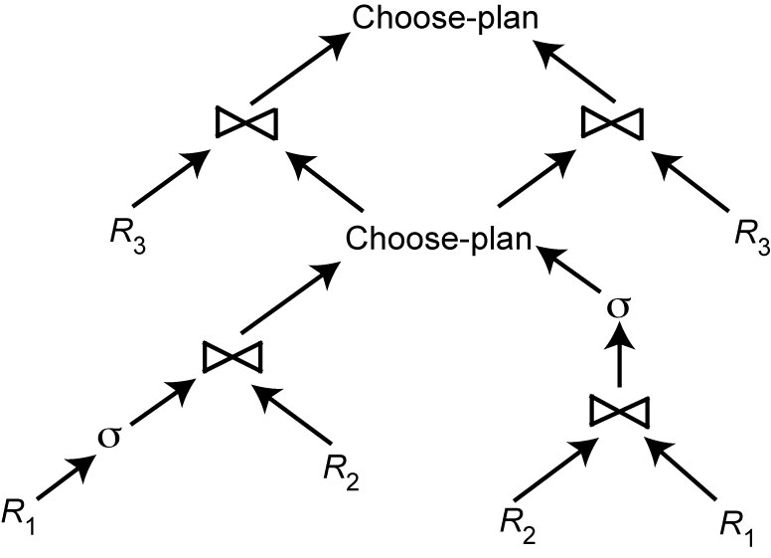
Hybrid Optimization Example
$a=A
$a=A

Slide 36
Join Ordering in Fragment Queries
Ordering joins
  Distributed INGRES
  System R*
  Two-step
Semijoin ordering
  SDD-1

Slide 37
Join Ordering
Consider two relations only
if size(R) < size(S)
R
S
if size(R) > size(S)
Multiple relations more difficult because too many alternatives.
  Compute the cost of all alternatives and select the best one.
    Necessary to compute the size of intermediate relations which is difficult.
  Use heuristics

Slide 38
Join Ordering – Example
Consider
  PROJ ⋈_{PNO} ASG ⋈_{ENO} EMP
Site 2
ASG
ENO
PNO
EMP
PROJ
Site 1
Site 3

Slide 39
Join Ordering – Example
Execution alternatives:
  1. EMP→ Site 2 2. ASG → Site 1
  Site 2 computes EMP'=EMP ⋈ ASG Site 1 computes EMP'=EMP ⋈ ASG
  EMP'→ Site 3 EMP' → Site 3
  Site 3 computes EMP' ⋈ PROJ Site 3 computes EMP’ ⋈ PROJ
  3. ASG → Site 3 4. PROJ → Site 2
  Site 3 computes ASG'=ASG ⋈ PROJ Site 2 computes PROJ'=PROJ ⋈ ASG
  ASG' → Site 1 PROJ' → Site 1
  Site 1 computes ASG' ▷◁ EMP Site 1 computes PROJ' ⋈ EMP
  5. EMP → Site 2
  PROJ → Site 2
  Site 2 computes EMP ⋈ PROJ ⋈ ASG

Slide 40
Semijoin Algorithms
Consider the join of two relations:
  R[A] (located at site 1)
  S[A](located at site 2)
Alternatives:
  Do the join R ⋈_{A}S
  Perform one of the semijoin equivalents
    R ⋈_{A}S ⇔ (R ⋉_{A}S) ⋈_{A}S
    ⇔ R ⋈_{A} (S ⋉_{A} R)
    ⇔ (R ⋉_{A} S) ⋈_{A} (S ⋉_{A} R)

Slide 41
Semijoin Algorithms
Perform the join
  send R to Site 2
  Site 2 computes R ⋈_{A} S
Consider semijoin (R ⋉_{A}S) ⋈_{A}S
  S' = Π_{A}(S)
  S' → Site 1
  Site 1 computes R' = R ⋉_{A}S'
  R'→ Site 2
  Site 2 computes R' ⋈_{A}S
Semijoin is better if
  size(Π_{A}(S)) + size(R ⋉_{A}S)) < size(R)

Slide 42
Distributed Dynamic Algorithm
Execute all monorelation queries (e.g., selection, projection)
Reduce the multirelation query to produce irreducible subqueries
q₁→ q₂ → … → q_{n}such that there is only one relation between q_{i} and q_{i+1}
Choose q_{i} involving the smallest fragments to execute (call MRQ')
Find the best execution strategy for MRQ'
  Determine processing site
  Determine fragments to move
Repeat 3 and 4

Slide 43
Static Approach
Cost function includes local processing as well as transmission
Considers only joins
“Exhaustive” search
Compilation
Published papers provide solutions to handling horizontal and vertical fragmentations but the implemented prototype does not

Slide 44
Static Approach – Performing Joins
Ship whole
  Larger data transfer
  Smaller number of messages
  Better if relations are small
Fetch as needed
  Number of messages = O(cardinality of external relation)
  Data transfer per message is minimal
  Better if relations are large and the selectivity is good

Slide 45
Static Approach –
Vertical Partitioning & Joins
1. Move outer relation tuples to the site of the inner relation
  (a) Retrieve outer tuples
  (b) Send them to the inner relation site
  (c) Join them as they arrive
    Total Cost = cost(retrieving qualified outer tuples)
    + no. of outer tuples fetched * cost(retrieving qualified inner tuples)
    + msg. cost * (no. outer tuples fetched * avg. outer tuple size)/msg. size

Slide 46
Static Approach –
Vertical Partitioning & Joins
2. Move inner relation to the site of outer relation
  Cannot join as they arrive; they need to be stored
    Total cost = cost(retrieving qualified outer tuples)
    + no. of outer tuples fetched * cost(retrieving matching inner tuples from temporary storage)
    + cost(retrieving qualified inner tuples)
    + cost(storing all qualified inner tuples in temporary storage)
    + msg. cost * no. of inner tuples fetched * avg. inner tuple size/msg. size

Slide 47
Static Approach –
Vertical Partitioning & Joins
3. Move both inner and outer relations to another site
    Total cost = cost(retrieving qualified outer tuples)
    + cost(retrieving qualified inner tuples)
    + cost(storing inner tuples in storage)
    + msg. cost ⋅ (no. of outer tuples fetched * avg. outer tuple size)/msg. size
    + msg. cost * (no. of inner tuples fetched * avg. inner tuple size)/msg. size
    + no. of outer tuples fetched * cost(retrieving inner tuples from temporary storage)

Slide 48
Static Approach –
Vertical Partitioning & Joins
4.Fetch inner tuples as needed
  (a) Retrieve qualified tuples at outer relation site
  (b) Send request containing join column value(s) for outer tuples to inner relation site
  (c) Retrieve matching inner tuples at inner relation site
  (d) Send the matching inner tuples to outer relation site
  (e) Join as they arrive
    Total Cost = cost(retrieving qualified outer tuples)
    + msg. cost * (no. of outer tuples fetched)
    + no. of outer tuples fetched * no. of inner tuples fetched * avg. inner tuple size * msg. cost / msg. size)
    + no. of outer tuples fetched * cost(retrieving matching inner tuples for one outer value)

Slide 49
Dynamic vs. Static vs Semijoin
Semijoin
  SDD1 selects only locally optimal schedules
Dynamic and static approaches have the same advantages and drawbacks as in centralized case
  But the problems of accurate cost estimation at compile-time are more severe
    More variations at runtime
    Relations may be replicated, making site and copy selection important
Hybrid optimization
  Choose-plan approach can be used
  2-step approach simpler

Slide 50
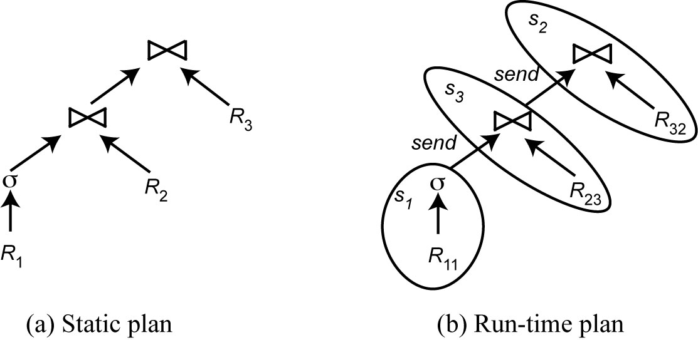
2-Step Optimization
At compile time, generate a static plan with operation ordering and access methods only
At startup time, carry out site and copy selection and allocate operations to sites

Slide 51
2-Step – Problem Definition
Given
  A set of sites S = {s₁, s₂, …,s_{n}} with the load of each site
  A query Q ={q₁, q₂, q₃, q₄} such that each subquery q_{i} is the maximum processing unit that accesses one relation and communicates with its neighboring queries
  For each q_{i} in Q, a feasible allocation set of sites S_{q}={s₁, s₂, …,s_{k}} where each site stores a copy of the relation in q_{i}
The objective is to find an optimal allocation of Q to S such that
  the load unbalance of S is minimized
  The total communication cost is minimized

Slide 52
2-Step Algorithm
For each q in Q compute load (S_{q})
While Q not empty do
  Select subquery a with least allocation flexibility
  Select best site b for a (with least load and best benefit)
  Remove a from Q and recompute loads if needed

Slide 53
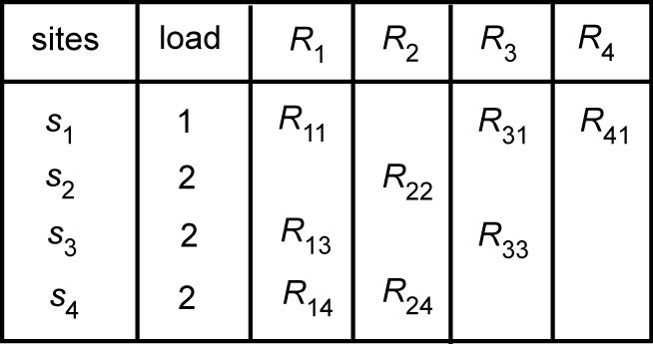
2-Step Algorithm Example
Let Q = {q₁, q₂, q₃, q₄} where q₁ is associated with R₁, q₂ is associated with R₂ joined with the result of q₁, etc.
Iteration 1: select q₄, allocate to s₁, set load(s₁)=2
Iteration 2: select q₂, allocate to s₂, set load(s₂)=3
Iteration 3: select q₃, allocate to s₁, set load(s₁) =3
Iteration 4: select q₁, allocate to s₃ or s₄
Note: if in iteration 2, q₂, were allocated to s₄, this would have produced
a better plan. So hybrid optimization can still miss optimal plans

